Slide 1
Recommender Systems
An Introduction

Slide 2
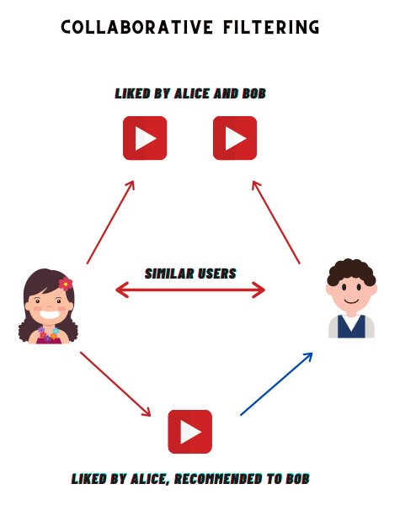
Types of Recommender Systems
Collaborative filtering
Memory based
User based
Just the user is important
Similar user’s choices would matter
Item based
Item is considered
Similar items would be offered
Model based
The ratings provided by the user based would matter
Fits an ML model to user interactions and metrics

Slide 3
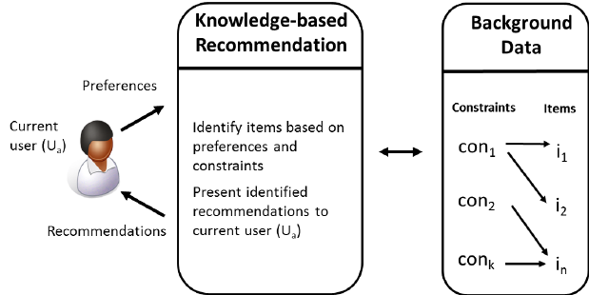
Types of Recommender Systems
Knowledge-base filtering
In cases of low number of available ratings (e.g. not everyday things)
Time based (e.g. values)
Requirement based (e.g. needs)

Slide 4
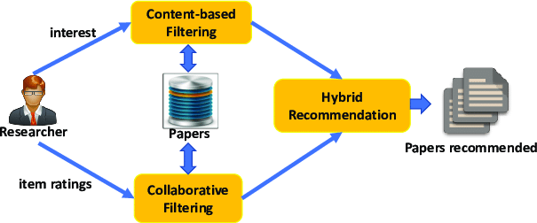
Types of Recommender Systems
Hybrid filtering
Combination of two or more algorithms
E.g. a model can be made that provides preferred items by most users with specific ratings for the selective categories

Slide 5
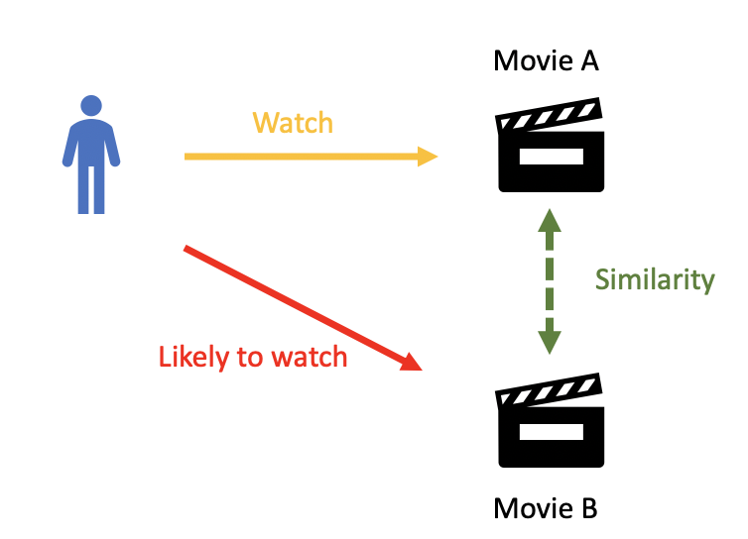
Types of Recommender Systems
Content based filtering
It doesn’t involve other users
Based on what we like items with similar contents are offered
Less diversity
Works without ratings
Items features and categories of choice are selectable (e.g. for movies based on actors, genre, director, etc.)

Slide 6
An example of Content based RS
Using Scikit-Learn package
TF-IDF or CountVectorizer: Depending on the importance of counting
Cosine Similarity: To find similar items

